Slide 1

Information geometry: A short introduction to the geometry of dual structures
Frank Nielsen
Sony Computer Science Laboratories Inc
Tokyo, Japan

Slide 2
Information geometry (IG): Rationale and scope
IG field originally born by investigating geometric structures of statistical/probability models (e.g, space of Gaussians, space of multinomials)
Statistical models: parametric vs nonparametric models, regular vs singular (ML) models, hierarchical (ML) or simple models, ...
Define statistical invariance, use language of geometry (e.g., ball, projection, bisector) to design algorithms in statistics, information theory, statistical machine learning, etc.
IG study interplays of statistical/parameter divergences with geometric structures
Relationships between many types of dualities in IG: dual connections, reference duality (dual f-divergences), Legendre duality, duality of representations/monotone embeddings, etc

Slide 3
Information geometry: Rationale and scope
More generally, Information Geometry = Dual geometry of models:
quantum information geometry of quantum models (space of density matrices with unit trace for modeling quantum states)
Geometric objects are defined globally and can be expressed locally in any convenient coordinate systems to ease computations, change of coordinate systems (atlas of manifolds)
Because the information-geometric structures are purely geometric (i.e., there is no attached meanings to objects), information-geometric structures can also be used in non-statistical contexts too, like mathematical programming (e.g., IG of barrier functions)

Slide 4
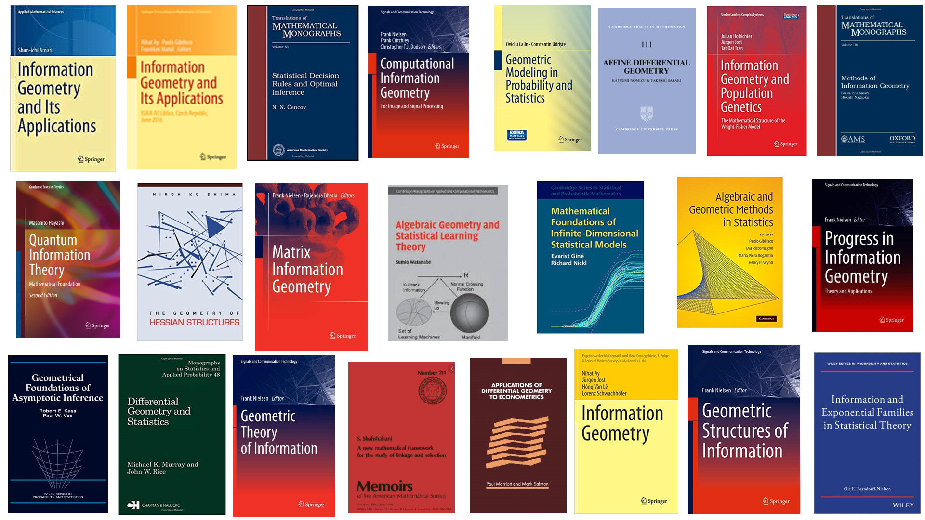

Slide 5
Geometric science of information (GSI)
Further extend broadly the original scope of information geometry by unravelling connections of information geometry (IG) with other domains of geometry like:
geometry of domains and cones (e.g., Siegel/Vinberg/Koszul)
geometric mechanics for dynamic models (symplectic/contact geometry)
thermodynamics/thermostatistics and deformed statistical models
geometric statistics (eg, computational anatomy/medical imaging)
shape space analysis and deformation (computer vision)
algebraic statistics (manifolds versus algebraic surfaces/varieties)
dynamics of learning (singularity, plateau)
neurogeometry (neuroscience)
etc.
franknielsen.github.io/GSI/

Slide 6
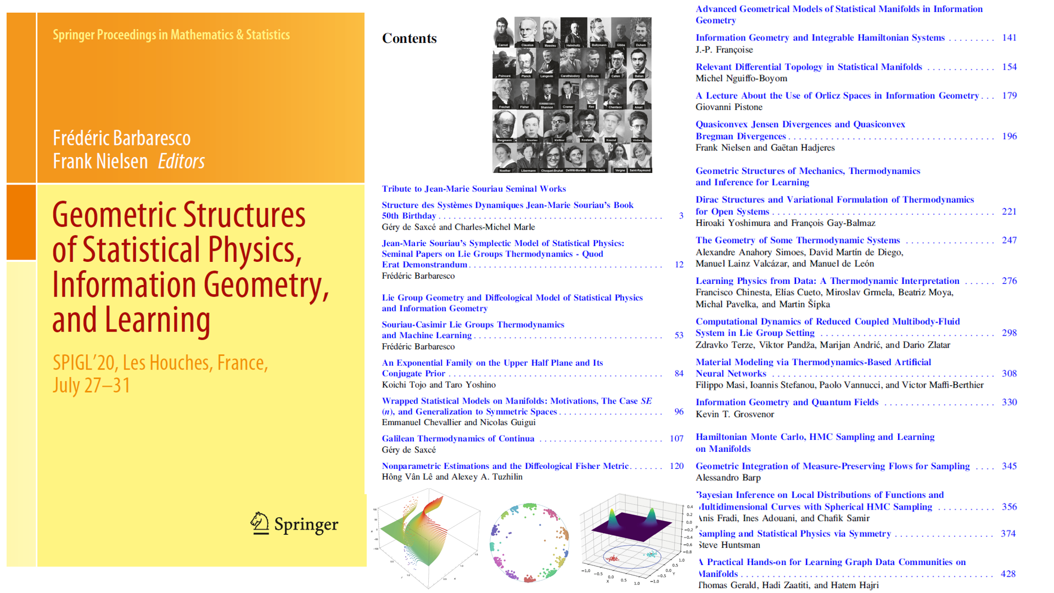
Many slide decks online :
https://franknielsen.github.io/SPIG-LesHouches2020/

Slide 7
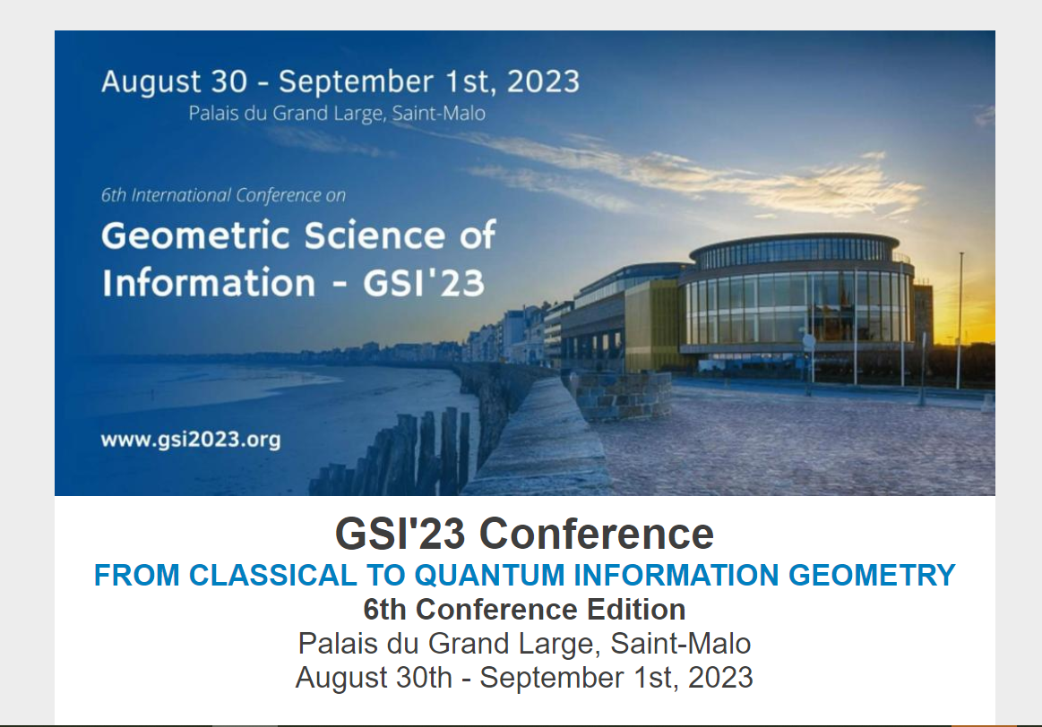

GSI: Biannual conference since 2013
https://conference-gsi.org/
Include 500+ GSI video talks:
franknielsen.github.io/GSI/

Slide 8
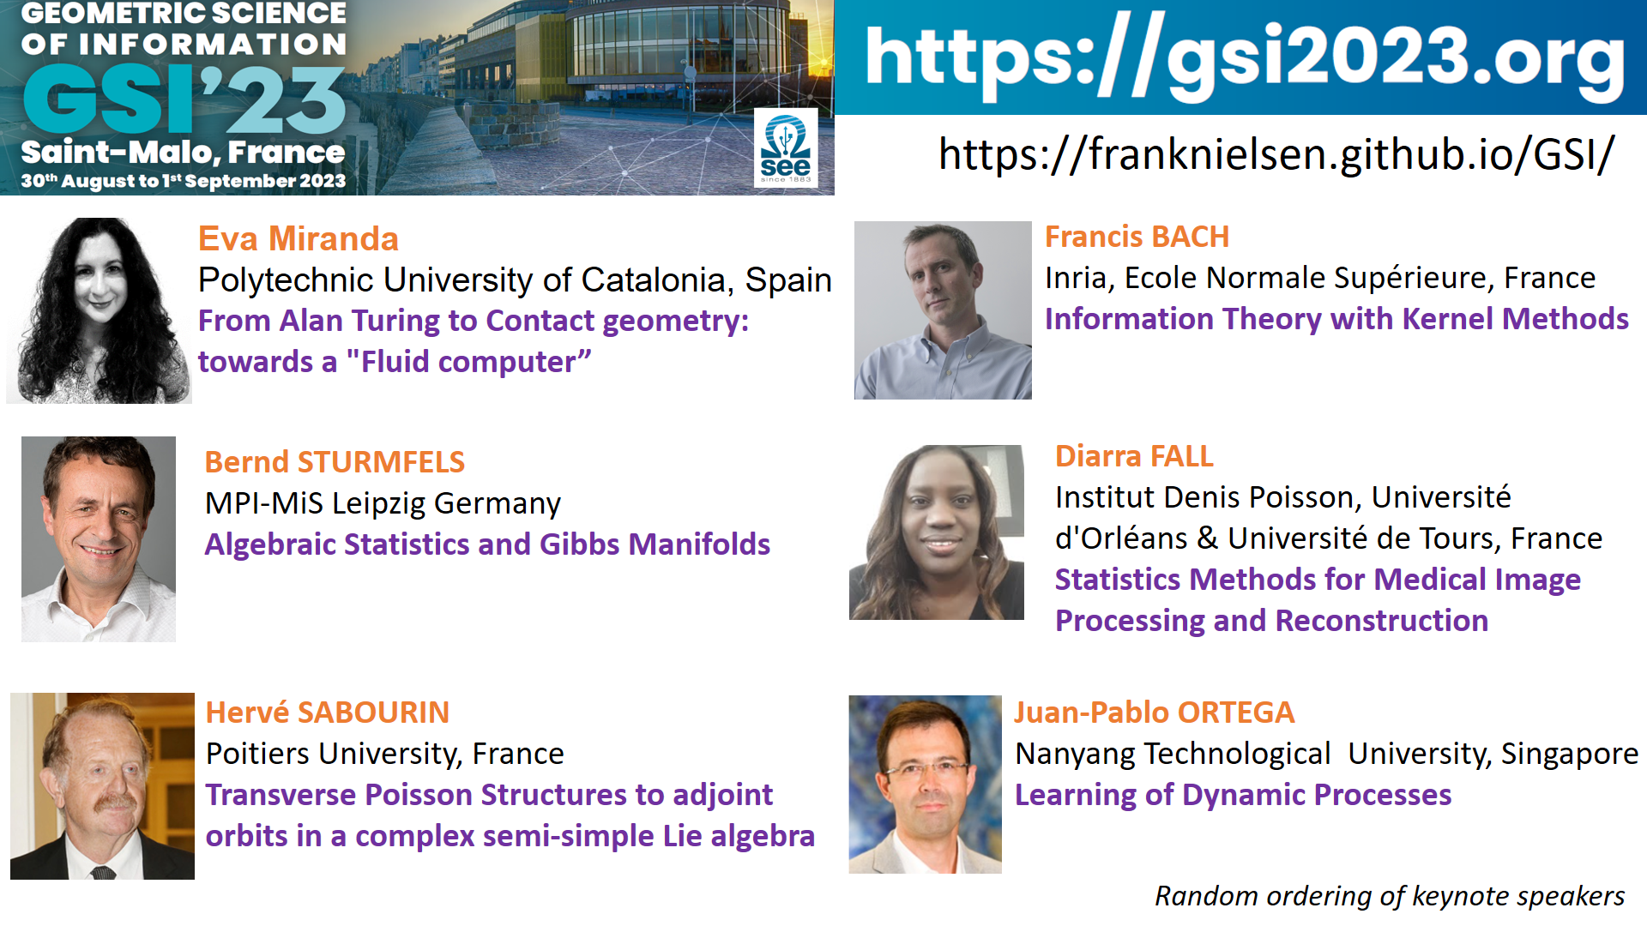

Slide 9
Information geometry: Geometry of dual structures
Applications:
Geometry of statistical models
Geometry of divergences

Slide 10
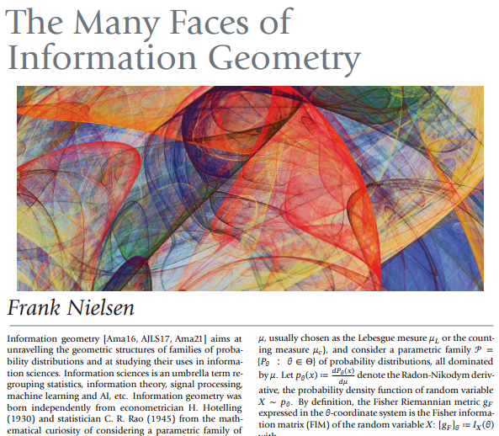


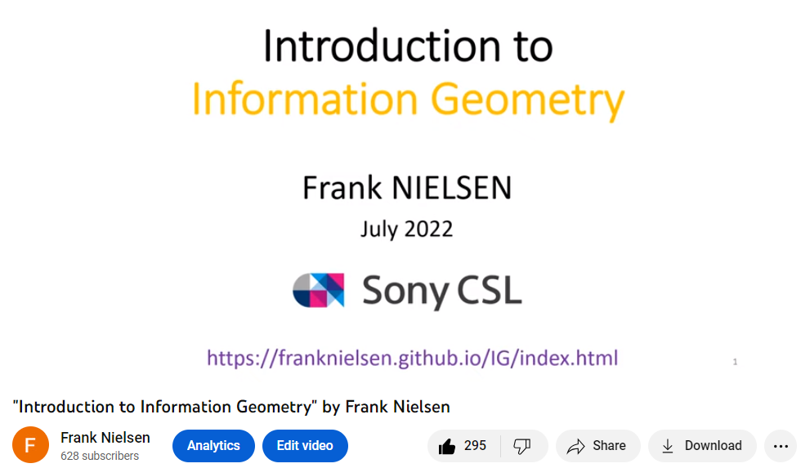
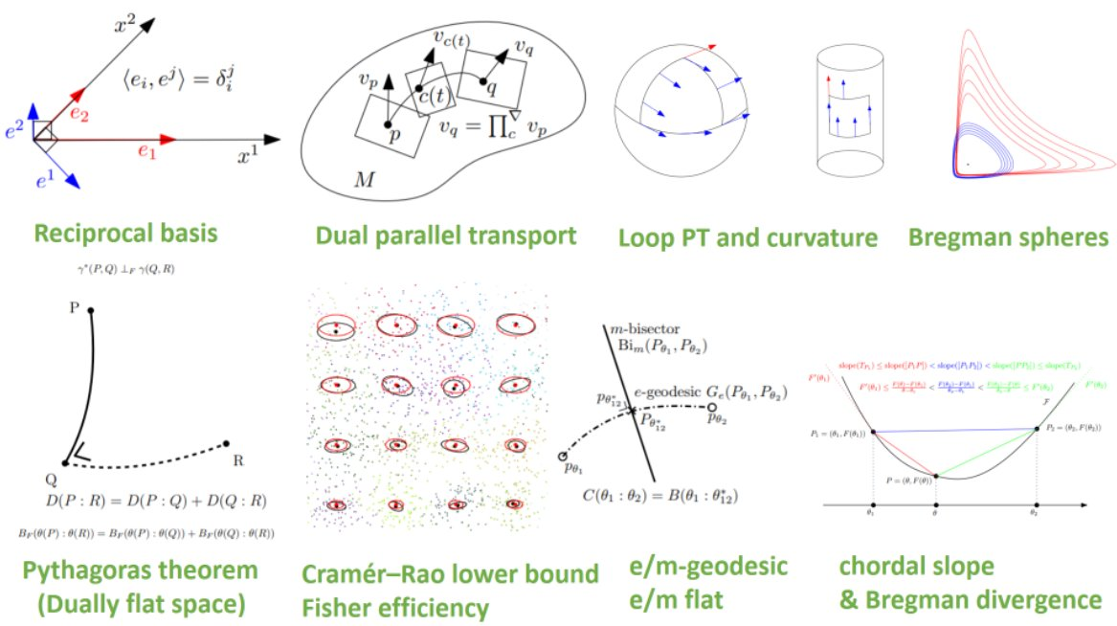
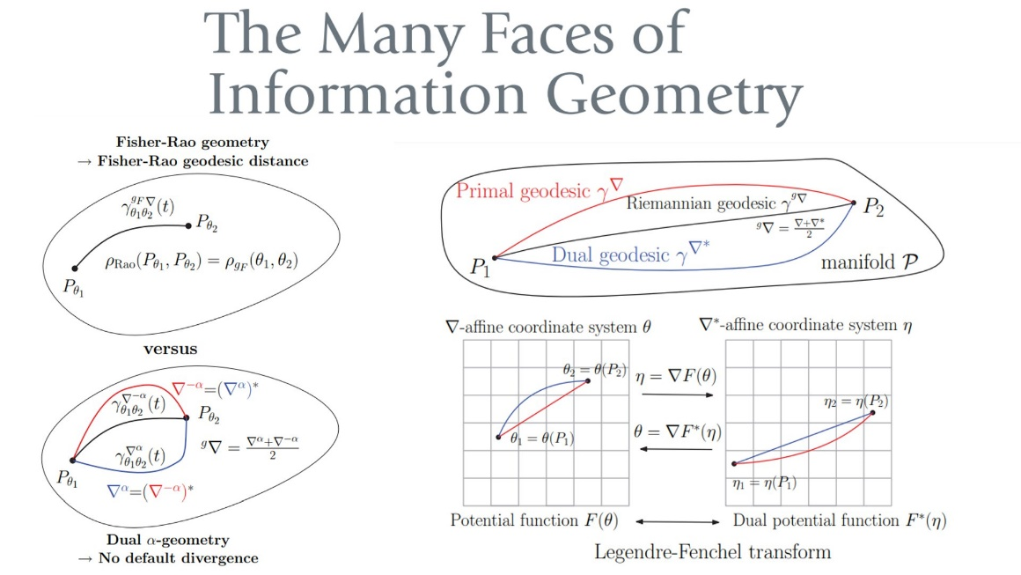
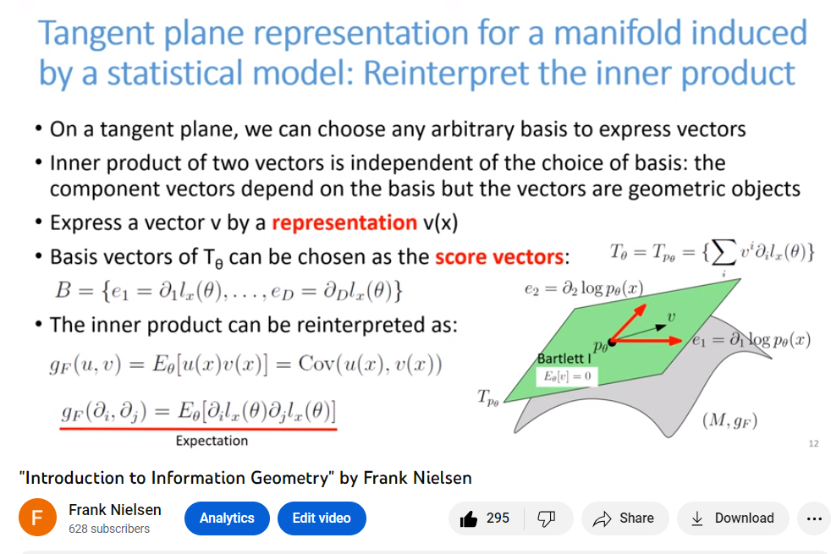
Some resources
Tutorial 60+ pages
https://www.mdpi.com/1099-4300/22/10/1100
Short overview 10 pages
https://www.ams.org/journals/notices/202201/rnoti-p36.pdf
40 min. video introduction
https://www.youtube.com/watch?v=w6r_jsEBlgU

Slide 11
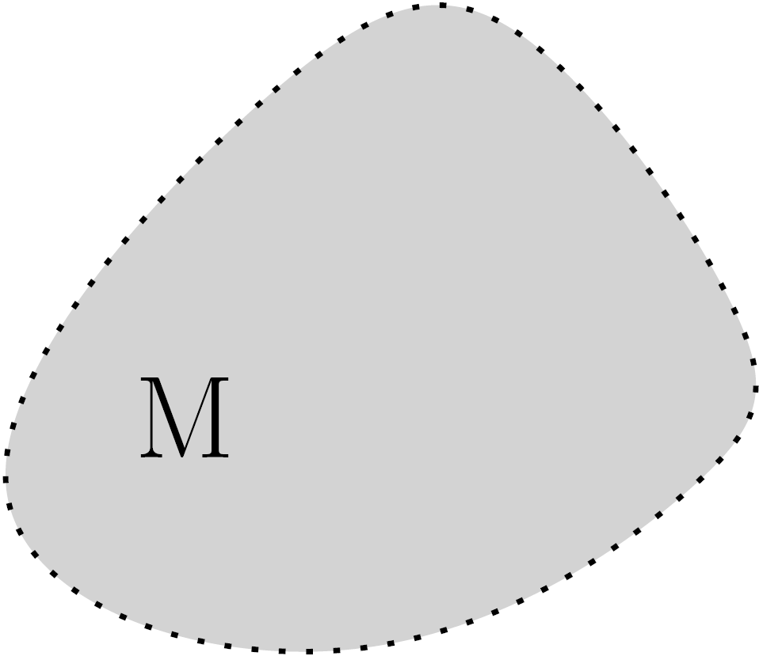
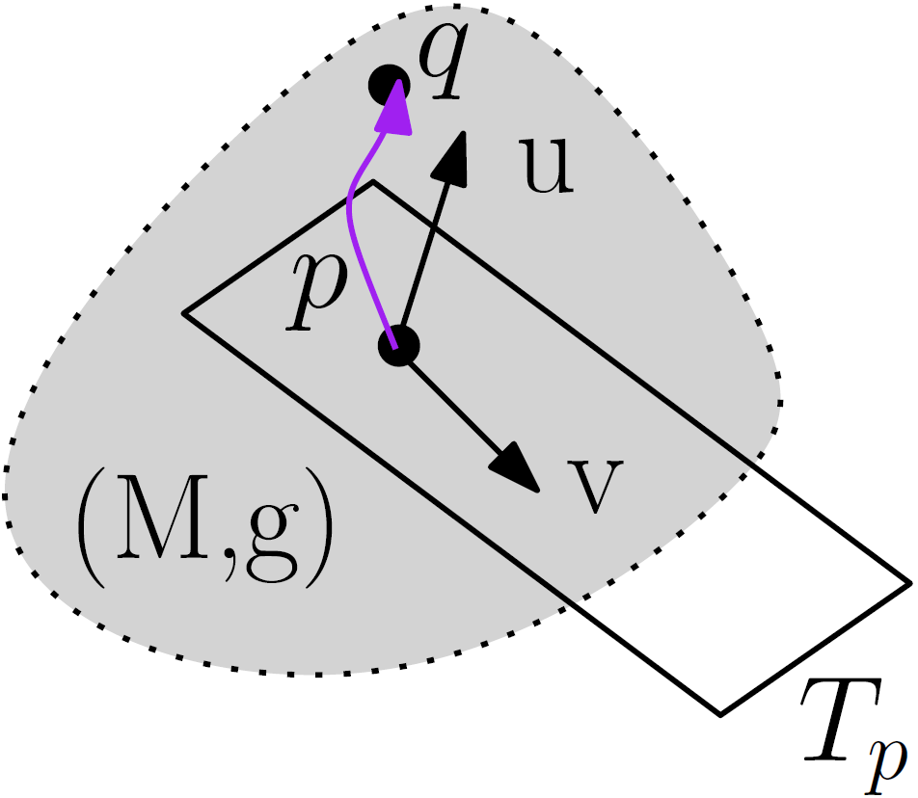
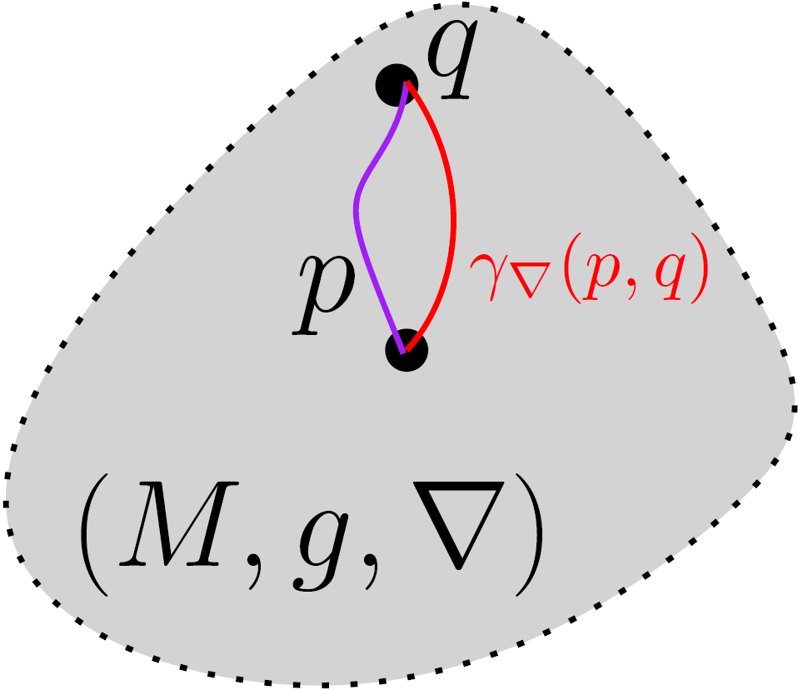
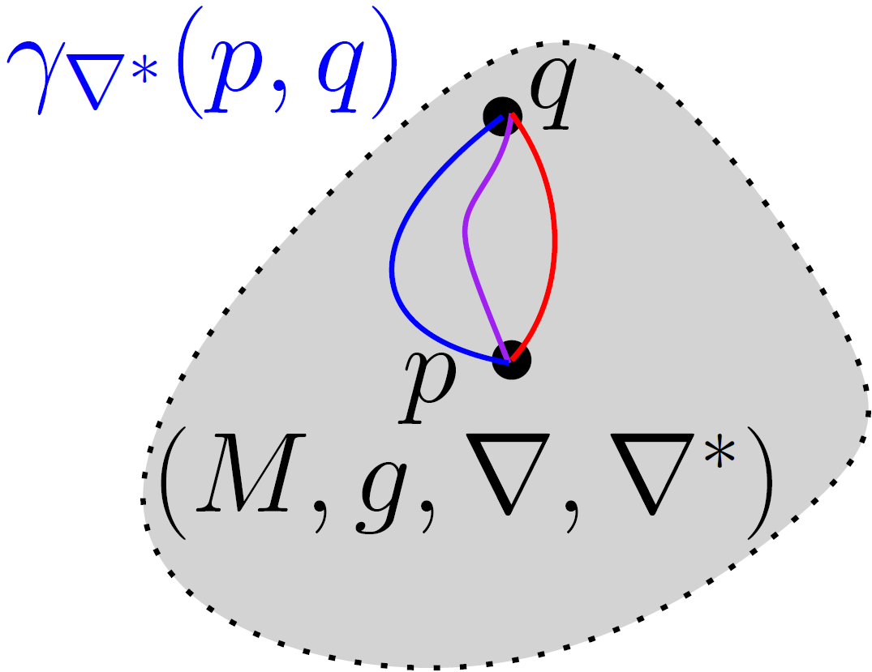

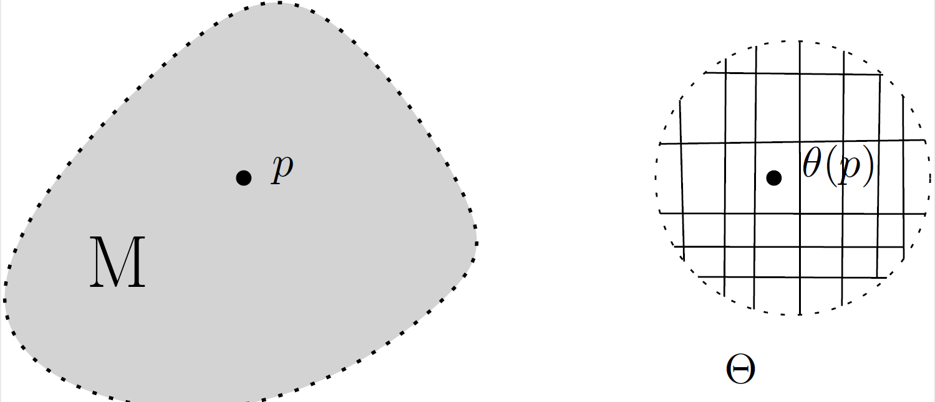
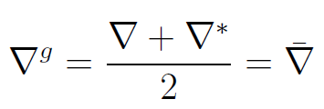
Build your own information geometry in three steps
Choose
Get dual IG
manifold
(M,g,∇,∇*)
① manifold M
② metric tensor g
③ affine connection ∇
du
dual
connection
Examples:
Gaussians
SPD cone
Probability simplex
Examples:
Fisher information metric
metric g^{D} from divergence
trace metric
Examples:
exponential connection
mixture connection
metric connection ∇^{g}
divergence connection ∇^{D}
α-connection
Concepts:
vector length
vector orthogonality
Riemannian geodesic
Riemannian distance
Levi-Civita connection ∇^{g}
chart
Concepts:
covariant derivative ∇
∇-geodesic
∇-parallel transport
curvature
Concepts:
local coordinates
locally Euclidean
Concepts:
dual connections coupled to metric g
dual parallel transport preserve metric g
Notes:
∇*=2∇^g- ∇

Slide 12
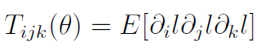
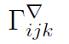
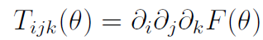
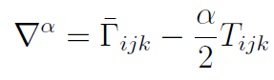
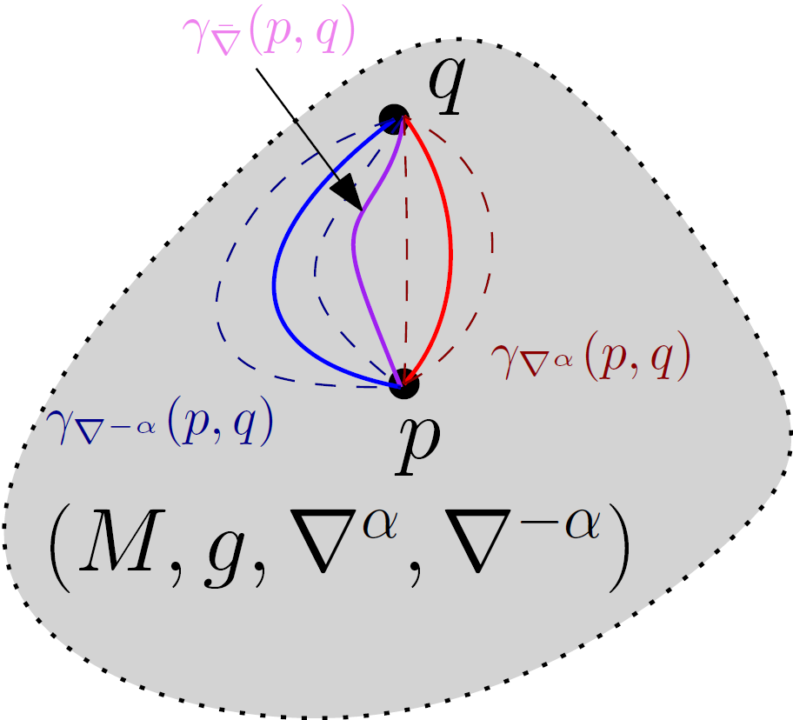
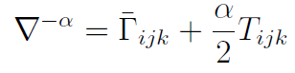
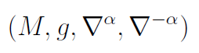
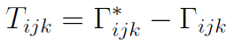
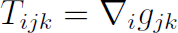
From dual information geometry to ±α-geometry, α∈ℝ
Choose
① manifold M
④ choose α
② metric tensor g
Examples:
Amari-Chentsov cubic tensor
Cubic tensor from divergence
③ affine connection ∇
by defining Christoffel symbols
Get dual IG manifold
(M,g,∇,∇*)
Get a family of dual connections/IG
(M,g,∇^{α},∇^{-α})
Cubic
tensor
±α-geometry
0-geometry
= Riemannian geometry
with geodesic distance
Notes:
$$
\Gamma_{ijk}^\nabla
$$
$$
T_{ijk}=\Gamma_{ijk}^*-\Gamma_{ijk}
$$
$$
T_{ijk}=\nabla_i g_{jk}
$$
$$
\nabla^\alpha=\bar{\Gamma}_{ijk}-\frac{\alpha}{2}T_{ijk}
$$
$$
\nabla^{-\alpha}=\bar{\Gamma}_{ijk}+\frac{\alpha}{2}T_{ijk}
$$
$$
(M,g,\nabla^\alpha,\nabla^{-\alpha})
$$
$$
T_{ijk}(\theta)=E[\partial_i l\partial_j l\partial_k l]
$$
$$
T_{ijk}(\theta)=\partial_i \partial_j\partial_k F(\theta)
$$

Slide 13
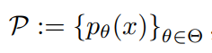
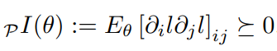
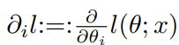
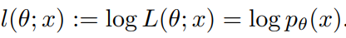
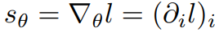
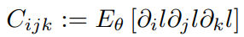
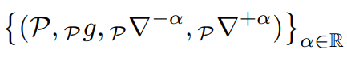
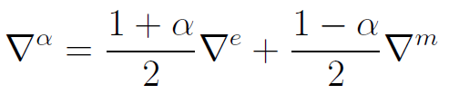
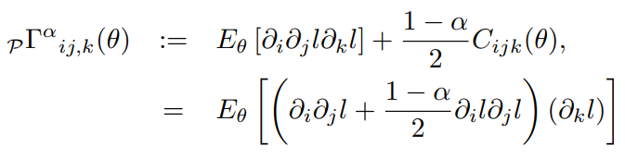
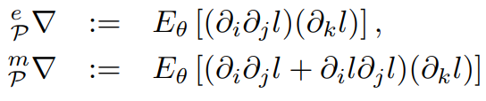
Information geometry from statistical models: (M,g^{F},∇^{-α},∇^{α})
Consider a parametric statistical/probability model:
Define metric tensor g from Fisher information = Fisher metric g^{F}
Model is regular if partial derivatives of l_{θ}(x) smooth and Fisher metric
is well-defined and positive-definite
Amari-Chentsov cubic tensor:
α-connections
Fisher-Rao geometry when α=0, get geodesic distance called Rao distance
Model Information Geometry (MIG)
covariance of the score
log-likelihood
α=1
exponential connection
α=-1
mixture connection
[Hotelling 1930]
[Rao 1945]
[Amari Nagaoka 1982]

Slide 14
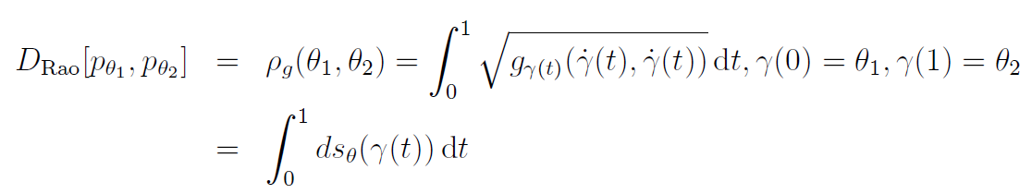
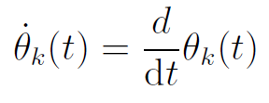
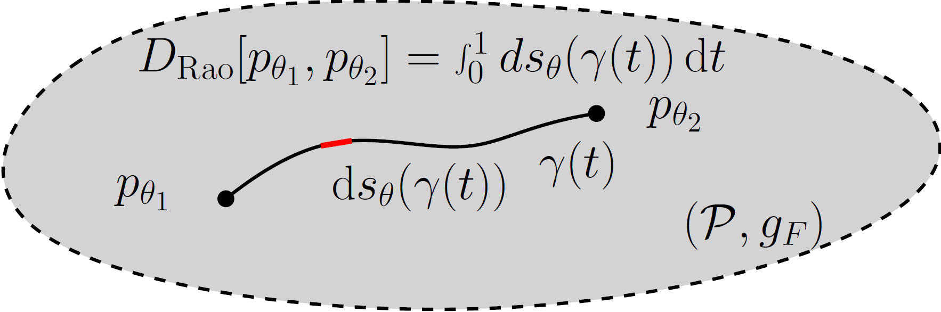
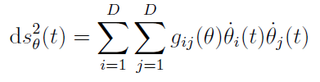
Rao distance on the Fisher-Rao manifold
Here, γ is the Riemannian geodesic
(or add a minimizer on all paths γ)
Length element
In practice:
Need to calculated geodesics which are curves locally minimizing the length linking two endpoints (equivalently minimize the energy of squared length elements)
Finding Fisher-Rao geodesics is a non-trivial tasks.
Good news 2023: closed-form geodesics with boundary conditions for MultiVariate Normals
Fisher-Rao and pullback Hilbert cone distances on the multivariate Gaussian manifold
with applications to simplification and quantization of mixtures, ICML ws TAGML 2023
Notes:
â à é è ç ê

Slide 15
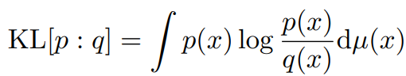
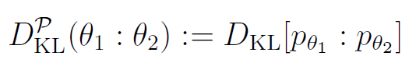
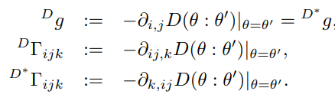
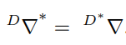
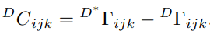
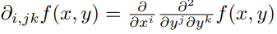
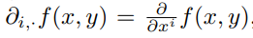
Information geometry from divergences: (M,g^{D},∇^{D},∇^{D*})
A statistical divergence like the Kullback-Leibler divergence is a smooth non-metric distance between probability measures
A statistical divergence between two densities of a statistical model is a parametric divergence (e.g., KLD between two normal distributions)
Construction of dual geometry from asymmetric parametric divergence D(θ₁:θ₂)
Dual divergence is D*(θ₁:θ₂)=D(θ₂:θ₁), reverse divergence
Divergence Information Geometry (DIG)
[Eguchi 1983]
Dual structure:
Cubic tensor:

Slide 16
Realizations of dual information geometry (stat mfd)
Realize (M,g,∇,∇) as a divergence information geometry (M,g^{D},∇^{D},∇^{D*}):
always exists a divergence D such that (M,g,∇,∇)=(M,g^{D},∇^{D},∇^{D*})
Matumoto, "Any statistical manifold has a contrast function—On the C3-functions taking the minimum at the diagonal of the product manifold." Hiroshima Math. J 23.2 (1993)
Realize (M,g,∇,∇) as a model information geometry (M,g^{F},∇^{-α},∇^{α})
always exists a statistical model M such that (M,g,∇,∇)=(M,_{P}g^{F},_{P}∇^{-α},_{P}∇^{α})
Lê, Hông Vân. "Statistical manifolds are statistical models." Journal of Geometry 84 (2006): 83-93.

Slide 17
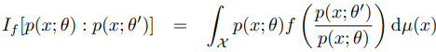
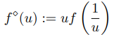
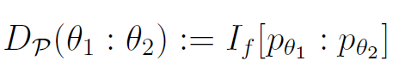
Equivalence: model α-IG ↔ divergence IG for f-divergences
Let P={p_{θ}} be a statistical model of probability distributions dominated by μ
Consider the f-divergence for a convex generator f(u) with f(1)=0, f'(1)=1, f''(1)=1 ← standard f-divergence (can always rescale g(u)=f(u)/f''(1))
The f-divergence between p_{θ1} and p_{θ2} is a parameter divergence D(θ₁:θ₂)
from which we can build the divergence information geometry (M,g^{D},∇^{D},∇^{D*})
Then model α-geometry for α=2 f'''(1)+3 coincide with divergence IG:
(M,g^{D},∇^{D},∇^{D*}) = (M,g^{F},∇^{-α},∇^{α}) for α=2 f'''(1)+3
metric tensor g^{D} and cubic tensor T^{D} coincides with Fisher metric g^{F} and Amari-Chentsov tensor T
Dual reverse f-divergence is a f-divergence for

Slide 18
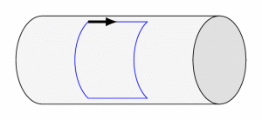
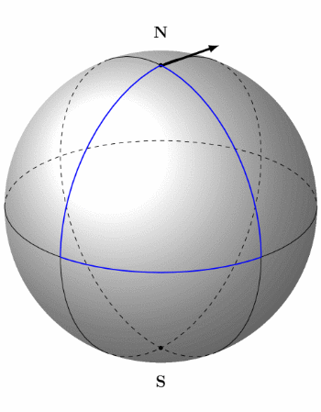
Curvature is associated to affine connection ∇
For Riemannian structure (M,g), use default Levi-Civita connection ∇=∇^{g}
Riemannian manifolds of dim d can always be embedded into Euclidean spaces E^{D} of dim D=O(d²)
Euclidean spaces have a natural affine connection ∇=∇^{E}
© CNRS
Cylinder is flat, 0 curvature:
Parallel transport along a loop of a vector preserves the orientation
Sphere has positive constant curvature:
Parallel transport along a loop exhibits
an angle defect related to curvature

Slide 19

Dually flat spaces (M,g,∇,∇*)
Fundamental theorem of information geometry: If torsion-free affine connection ∇ is of constant curvature κ, then curvature of dual torsion-free affine connection ∇* is also constant κ
Corollary: if ∇ is flat (κ=0) then ∇* is flat: Dually flat space (M,g,∇,∇*)
A connection ∇ is flat if there exists a local coordinate system θ such that Γ(θ)=0
In ∇-affine coordinate system θ(.), ∇-geodesics are visualized as line segments
Γ(θ)=0
geodesics=line segments in θ

Slide 20



Canonical divergences of DFSs: Bregman divergences
Dually flat structure (M,g,∇,∇*) can be realized by a Bregman divergence
Let F(θ) be a strictly convex and differentiable function defined on an open convex domain ϴ
Bregman divergence interpreted as the vertical gap between
point (θ_{1,} F(θ₁)) and the linear approximation of F(θ) at θ₂ evaluated at θ₁ :
[Bregman 1967]
Notes:
â à é è ç ê

Slide 21




Legendre-Fenchel transformation: Slope transformation
Consider a Bregman generator of Legendre-type (proper, lower semi-continuous). Then its convex conjugate obtained from the Legendre-Fenchel transformation is a Bregman generator of Legendre type.
Analogy of the Halfspace/Vertex representation of the epigraph of F
Fenchel-Moreau’s biconjugation theorem for F of Legendre-type:
Concave programming:
Epigraph
Slope
[Touchette 2005] Legendre-Fenchel transforms in a nutshell
[2010] Legendre transformation and information geometry
Notes:
proper, lower semi-continuous, and convex function,

Slide 22







Mixed coordinates and the Legendre-Fenchel divergence
Dual Legendre-type functions
Convex conjugate of F is
Fenchel-Young inequality :
with equality holding if and only if
Fenchel-Young divergence make use of the mixed coordinate systems θ et η to express a Bregman divergence as :
Gradient
are inverse
of each other
Notes:
â à é è ç ê

Slide 23







Generalized Pythagoras theorem in dually flat spaces
In general, Identity of Bregman divergence with three parameters = law of cosines
Generalized Pythagoras’ theorem
Pythagoras’ theorem in
the Euclidian geometry
(Self-dual)
orthogonality condition:
Notes:
â à é è ç ê ù û ï

Slide 24



Slide 25



Dually flat space from a smooth strictly convex function F(θ)
A smooth strictly convex function F(θ) define a Bregman divergence and hence a dually flat space via Eguchi's divergence-based IG
Examples of DFSs induced by convex functions:
Domain
dual Bregman divergences

Slide 26
Some references
Amari, Shun-ichi, and Hiroshi Nagaoka. Methods of information geometry. Vol. 191. American Mathematical Soc., 2000.
Amari, Shun-ichi. Information geometry and its applications. Vol. 194. Springer, 2016.
Calin, Ovidiu, and Constantin Udrişte. Geometric modeling in probability and statistics. Vol. 121. Berlin, Germany:: Springer, 2014.
Nielsen, Frank. "An elementary introduction to information geometry." Entropy 22.10 (2020): 1100.
Nielsen, Frank. "Legendre transformation and information geometry." no. CIG-MEMO2 (2010).
Nielsen, Frank. "On geodesic triangles with right angles in a dually flat space." Progress in Information Geometry: Theory and Applications. Cham: Springer International Publishing, 2021. 153-190.

